Slide 1
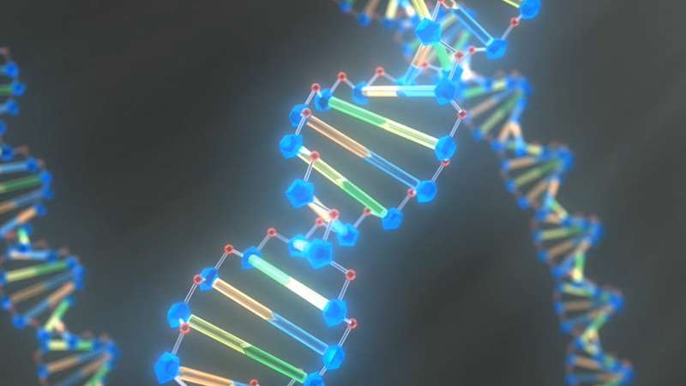

Biological Databases and Resources
Practical Sessions
Gildas Hounmanou, PhD
APTI-Fellow, National Institutes of Health, MD, USA
Assistant-Professor
https://orcid.org/0000-0003-3991-0864
University of Copenhagen
Faculty of Health and Medical Sciences

Slide 2
Database Searching Retrieval and Exporting
Define a target
Identify the right platform
Retrieve and store specific data
Import Data for downstream analysis

Slide 3
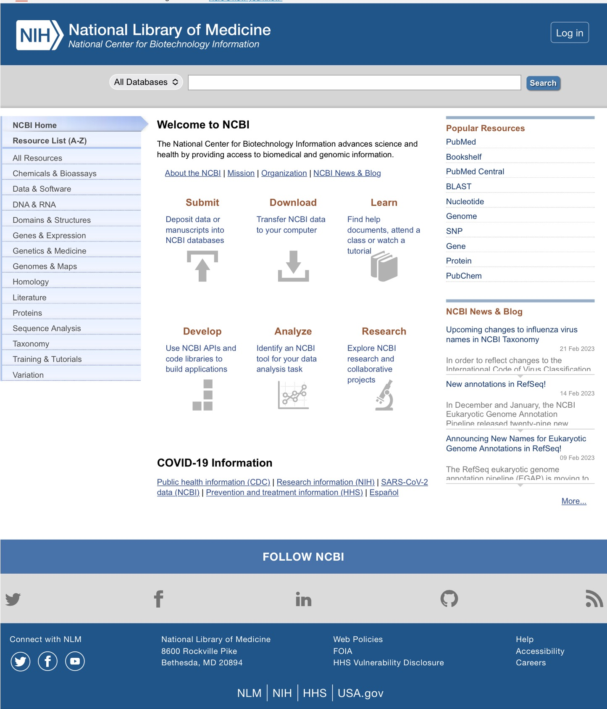
Search, Export and Store a biological sequence data from NCBI.
Open NCBI Website:
https://www.ncbi.nlm.nih.gov/
Identify Streptococcus agalactiae DNA for 16S rRNA, strain ATCC 23956
Retrieve (Download) the sequence

Slide 4
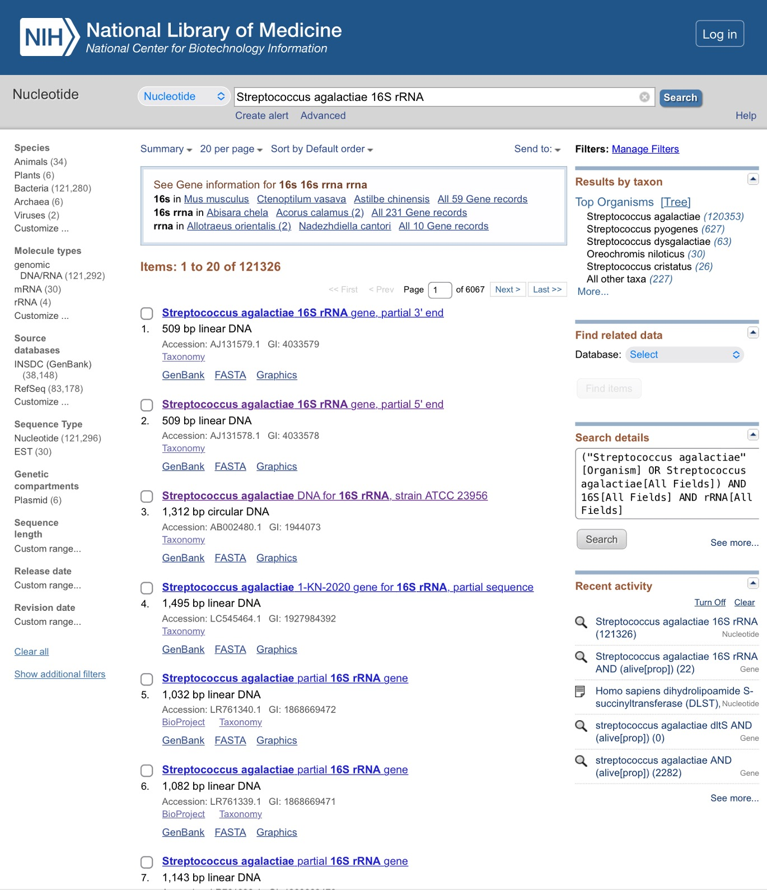
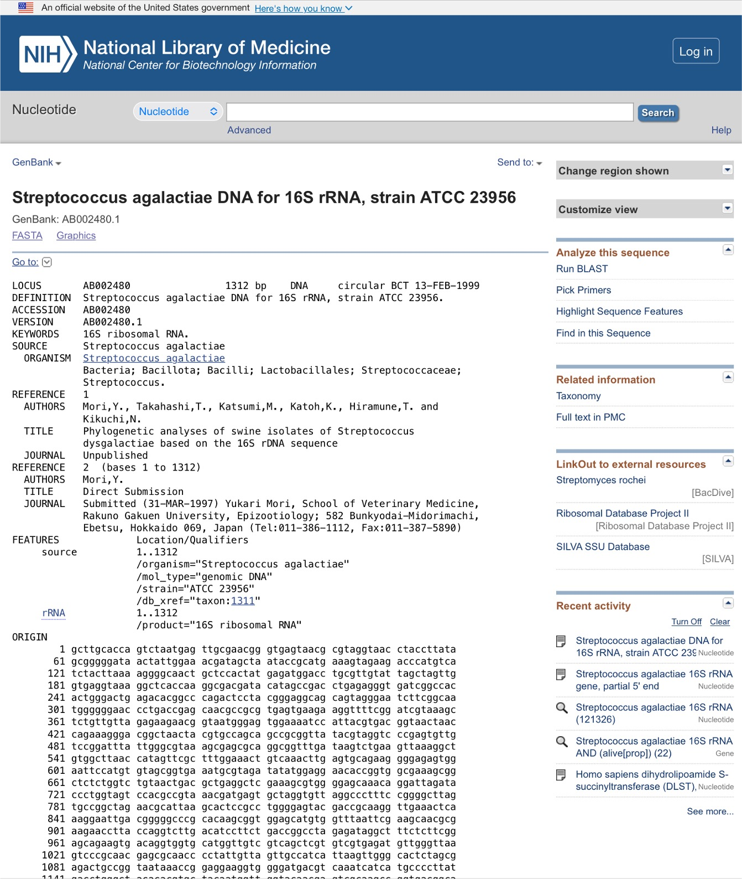
1. Search
2. Retrieve/ Store

